Slide 1
The use of text analytics to measure Quality Perception and Patient Understanding of Patient Information Leaflets –Knowledge Capture
Fernando Santos
fss1g15@soton.ac.uk
ECS/FoM
Supervisors:
Prof Jeremy Wyatt, Prof Thanassis Tiropanis

Slide 2
Research objective
The objective is to determine if text analytics techniques currently employed in the analysis of Web text can be used to improve Public reviews of Patient Information Leaflets (PILs) for Randomised Controlled Trials (RCTs).

Slide 3
Research motivation
We want to improve trial recruitment, by:
Improving patient understanding of essential trial features from patient information leaflets (PILs)
Capturing the knowledge generated by PPI groups
Helping Principal Investigators (PIs) identify problems in their PILs

Slide 4
Overall research methodology
Methodology Overview
Data Collection
Data Analysis
Hypothesis Testing

Slide 5
Overall research methodology
Methodology Development
Data Collection
Data Analysis
Hypothesis Testing
Our overall research consists of 3 studies:
Comparison of PILs to other kinds of text
Analysis of comments given to PILs with poor recruitment
Measuring the effect of Web analytics reports at increasing PIL readability (Future)

Slide 6
Overall research methodology
Methodology Development
Data Collection
Data Analysis
Hypothesis Testing
Our overall research is product of 3 studies:
Comparison of PILs to other kinds of text
Analysis of comments given to PILs with poor recruitment
Comparing the effect of Web analytics reports in increasing PIL readability (Future)

Slide 7
Overall research methodology
Methodology Development
Data Collection
Data Analysis
Hypothesis Testing
Obtain comments for PILs with poor recruitment (less than 15%)
Capture participant (n=24) information
Assess the participant perception of the PIL
Evaluate the participant understanding of the essential trial features described in the PIL

Slide 8
Overall research methodology
Methodology Development
Data Collection
Data Analysis
Hypothesis Testing
Classify the comments by their association with the participant perception of quality or understanding of trial features
Evaluate lexical similarity of the commented PIL sections
Identify participant demographics associated with the participants understanding or their perception of PIL quality.

Slide 9
Overall research methodology
Methodology Development
Data Collection
Data Analysis
Hypothesis Testing
Based on the collected information we will test in a future RCT if feedback reports based on Web analytics help PIs improve their PILs:
Quantitative content analysis metrics
Sentiment analysis (polarity/emotion)
Knowledge database (Previous PIL comments / good writing insights)

Slide 10
Metrics
Participant information
Quality assessment
Participant understanding
Content analysis
We acquired the following demographics:
Previous participation in RCTs
Proclivity to participate in RCTs
Education level
Age group
Gender
Origin
GP visits

Slide 11
Metrics
Participant information
Quality assessment
Participant understanding
Content analysis
We acquired the following demographics:
Previous participation in RCTs
Proclivity to participate in RCTs
Education level
Age group
Gender
Origin
GP visits

Slide 12
Metrics
Participant information
Quality assessment
Participant understanding
Content analysis
The participant’s subjective assessment of the PIL quality was recorded by employing an unipolar analogue scale graded 0 (poor) to 10 (excellent)

Slide 13
Metrics
Participant information
Quality assessment
Participant understanding
Content analysis
We measured the participant understanding by quantifying the percentage of correct answers to a questionnaire based on the topics of the EQIP scale (Chavert-Berard 2008).
Notes:
The Ensuring quality information for patients (EQIP) scale was developed at Geneva University Hospitals (Switzerland) to assess the content and structure of patient information documents

Slide 14
Metrics
Participant information
Quality assessment
Participant understanding
Content analysis
The EQIP scale considers the content and structure of PILs:
Sample definition
Definition of purpose
Treatment alternatives
Description of the procedure
Quant-Qual. benefits, risks & side-effects

Slide 15
Metrics
Participant information
Quality assessment
Participant understanding
Content analysis
We measured the associations between the comment features and the participant understanding or quality perception using the comment type, NLTK sentiment polarity, NRC Emotion Lexicon, and the lexical similarity of the commented sections on the PILs
Notes:
NRC- Canada National Research Council.
NLTK-Natural Language Processing Toolkit

Slide 16
Participants
24 public reviewers from 3rd Millennium Age Centre

Slide 17
Results
We captured a total of 240 comments:

Slide 18
Findings
Correlation analysis:
Significant negative correlation between age group and quality grade given to the PIL
Significant positive correlation between the education level and EQIP score
Significant positive correlation between the number of specific comments and the EQIP score

Slide 19
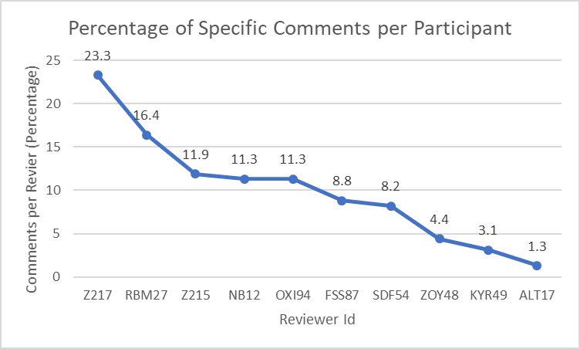
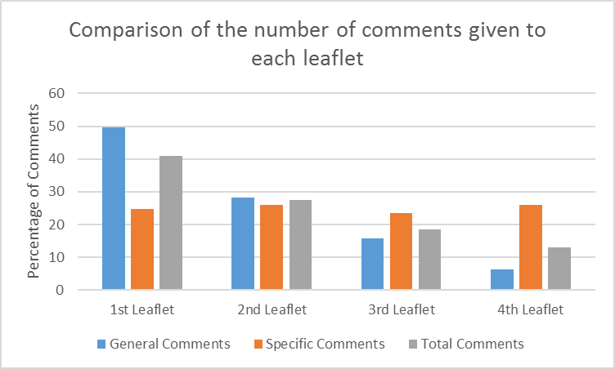
Histograms

Slide 20
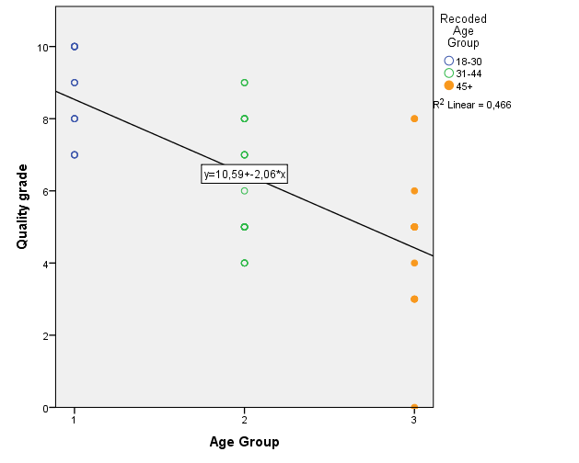
Relation between age group and quality perception
y=10.6-2.1x
18-30
31-44
45+

Slide 21
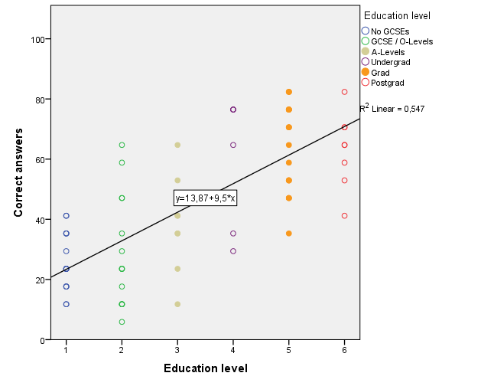
Relation between education level and EQIP score
y=13.9+9.5x
No GCSE
GCSE /
O-Level
A-Levels
Undergrad
Grad
Postgrad

Slide 22
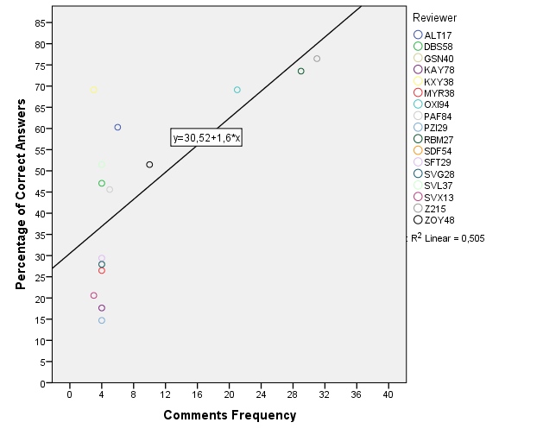
Relation between the number of comments & EQIP score
y=30.5+1.6x

Slide 23
Conclusions
Only 42% of participants gave comments about specific sections of the leaflets
There was no significant association between the number of general comments and the subjective quality grades or the percentage of correct answers (EQIP score).
The leaflet’s capacity to inform participants cannot be determined by purely taking into account general comments or subjective quality grade – use specific comments and EQIP score
Fernando Santos Sanchez, fss1g15@soton.ac.uk

